Slide 1

BUSINESS ANALYST JOBS IN HONGKONG
Shalvi Sudhir Deshmukh

Slide 2
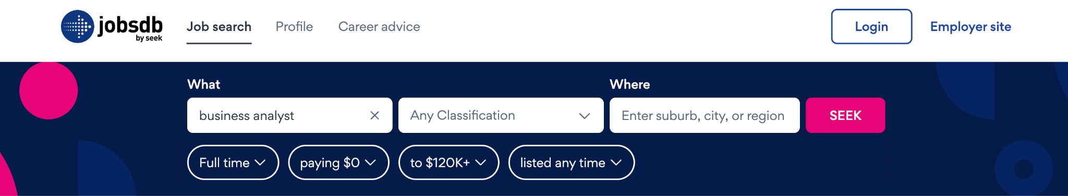
CONTENTS
Introduction
Research question
Data Collection
Data Set Insights
Data Preparation
Data Preprocessing
Data Visualization
Comprehensive review of Dataset
Challenges
Recap and Insights

Slide 3
INTRODUCTION
The objective of this project is to collect and analyze salary data for Business Analyst jobs in the Hongkong.
By scraping salary information from job search portal, we aim to gain insights into the salary landscape for Business Analysts. The data we use is collected from Jobsdb website.
Jobsdb.com assists in searching jobs across HongKong, Singapore, Thailand
Lists job information such as Company Profile, Job Role, Location, Required SkillSet, Salary, Work Culture and so on

Slide 4

RESEARCH QUESTION
How does the salary distribution and job availability vary among different companies, job roles, and regions for business analyst positions in the IT industry, as observed from data extracted from the jobsdb website?

Slide 5



DATA COLLECTION
HTTPS://HK.JOBSDB.COM/BUSINESS-ANALYST-JOBS/FULL-TIME
WEB SCRAPING
CSV FILE WITH 1. JOB TITLE
2. COMPANY NAME
3. LOCATION
4. JOB DESCRIPTION
5.SALARY
Notes:
Hello

Slide 6
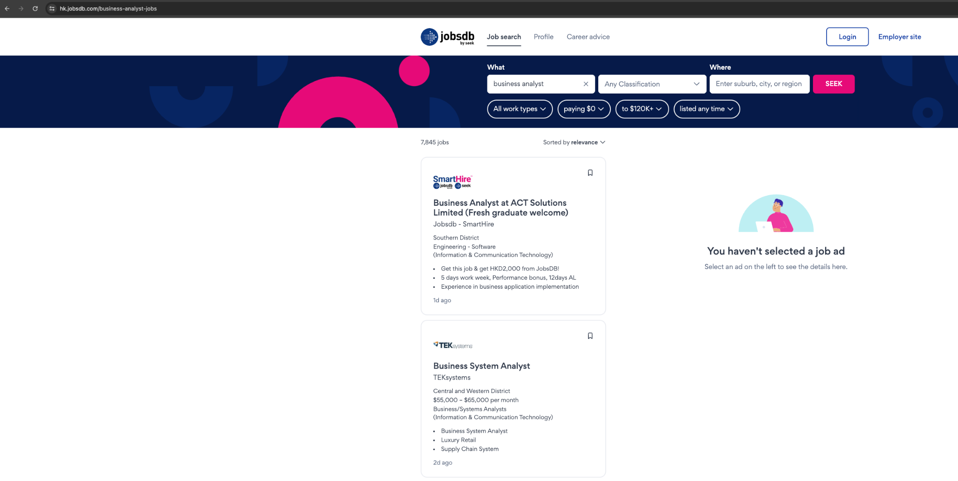

Slide 7
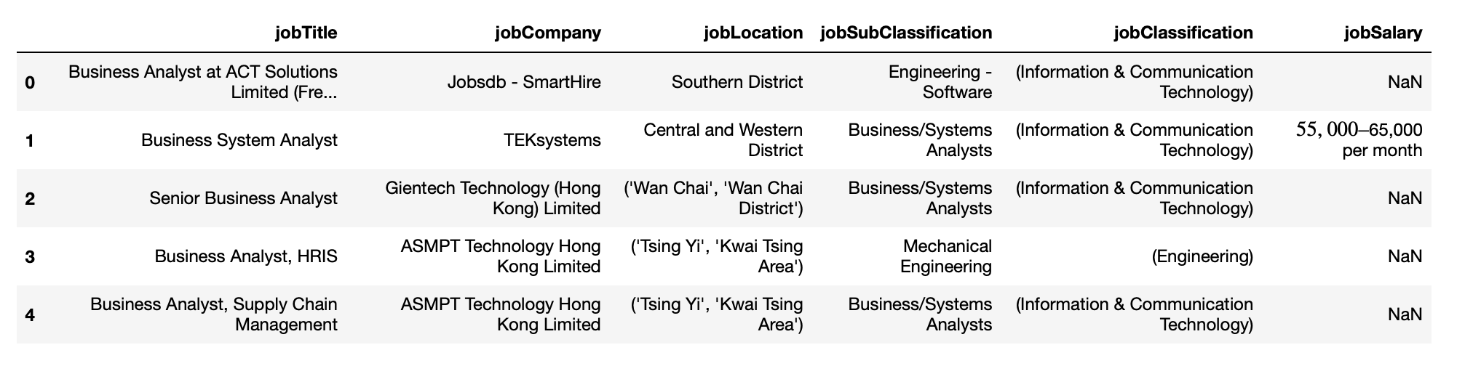
DATA SET INSIGHTS : WEB SCRAPING

Slide 8

DATA PREPARATION
Identified discrepancies in dataset during analysis.
Discrepancies included quotation marks, braces, or brackets in columns.
Employed cleaning procedures to rectify issues.
Removed extraneous characters for data standardization.
Enhanced reliability and interpretability of findings by addressing inconsistencies.
Notes:
During our analysis of the dataset, we noticed some inconsistencies which made it a bit messy. Things like quotation marks, braces, or brackets were scattered throughout the columns, making it difficult to work with. To tidy things up, we applied some cleaning procedures. Essentially, we got rid of these extra characters to make the data consistent and easier to understand.
By doing this, we ensured that the data was standardized, meaning it followed a uniform format throughout. This not only made our findings more reliable but also made it much easier to interpret the results. So, in a nutshell, we cleaned up the dataset by removing unnecessary characters, making the information clearer and more reliable for our analysis.

Slide 9



DATA PRE-PROCESSING
Encountered missing values during data processing.
Employed systematic approach for effective handling.
Dropped inconsequential missing values.
Imputed missing job salary values with most frequent value.
Decision aimed to maintain overall data distribution.
Strategies focused on dataset robustness and meaningful insights.
Notes:
While processing our data, we noticed some missing values, which means there were some empty spaces where information should have been. To deal with this, we followed a systematic approach to ensure we handled it effectively.
First, we dropped any missing values that weren't significant or didn't have much impact on our analysis. Then, for missing job salary values, we used the most frequent value to fill in the gaps. This decision was made to maintain the overall distribution of the data.
Our main goal was to make sure our dataset stayed strong and that we could still draw meaningful insights from it. By focusing on strategies that kept the data robust and meaningful, we were able to tackle the missing values without losing valuable information.

Slide 10
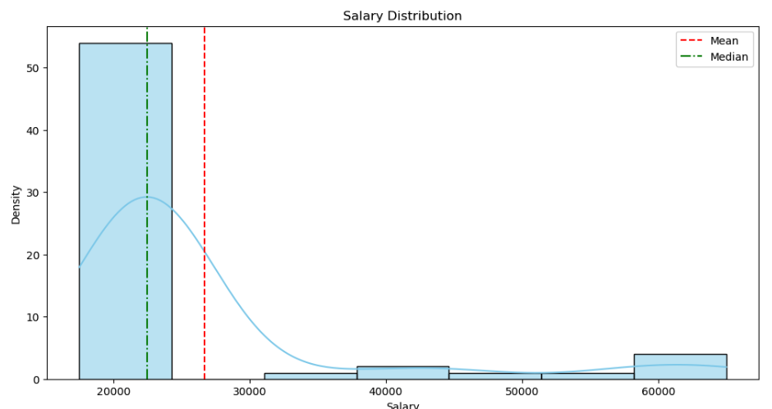
DATA VISUALIZATION
This graph helps in identifying the central tendency of salaries, such as the median or mean salary, and the distribution is rightly skewed towards higher salaries.
This means that there are relatively few data points with very high salaries, while the majority of data points have lower salaries.

Slide 11
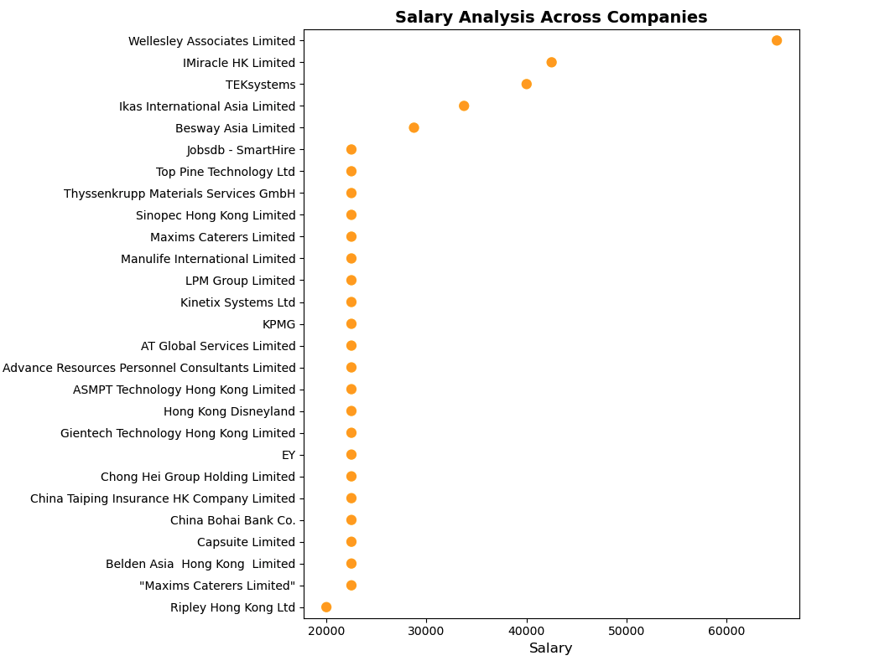

Slide 12
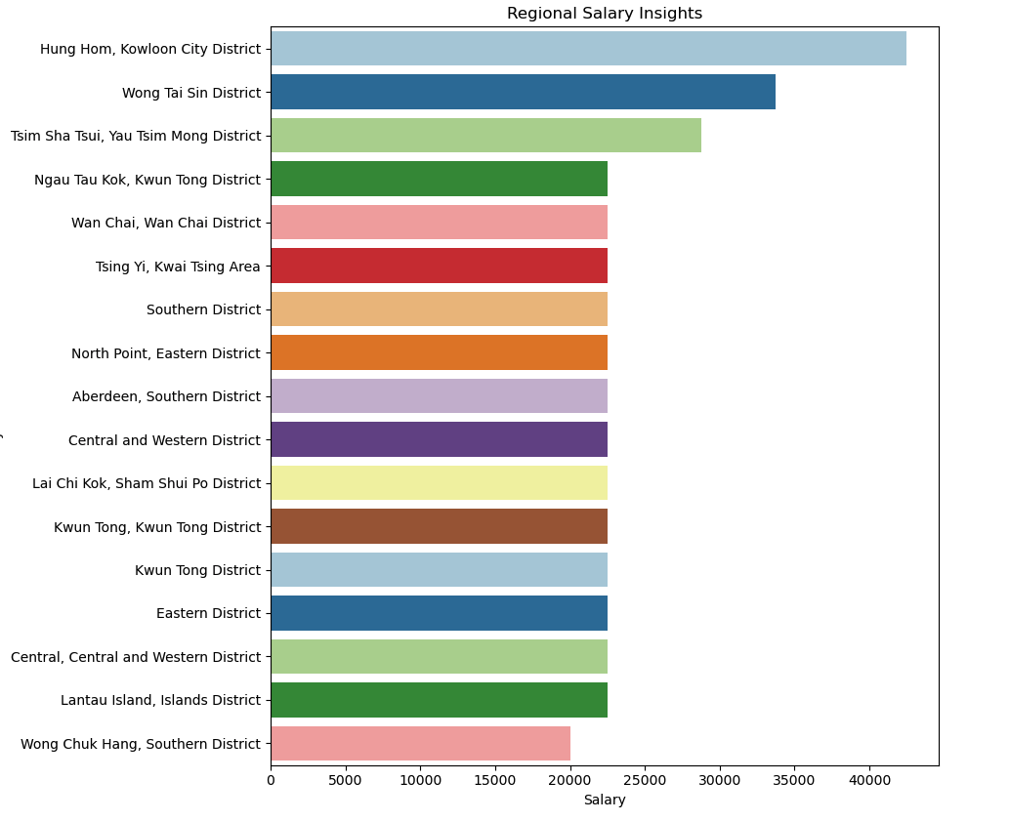

Slide 13
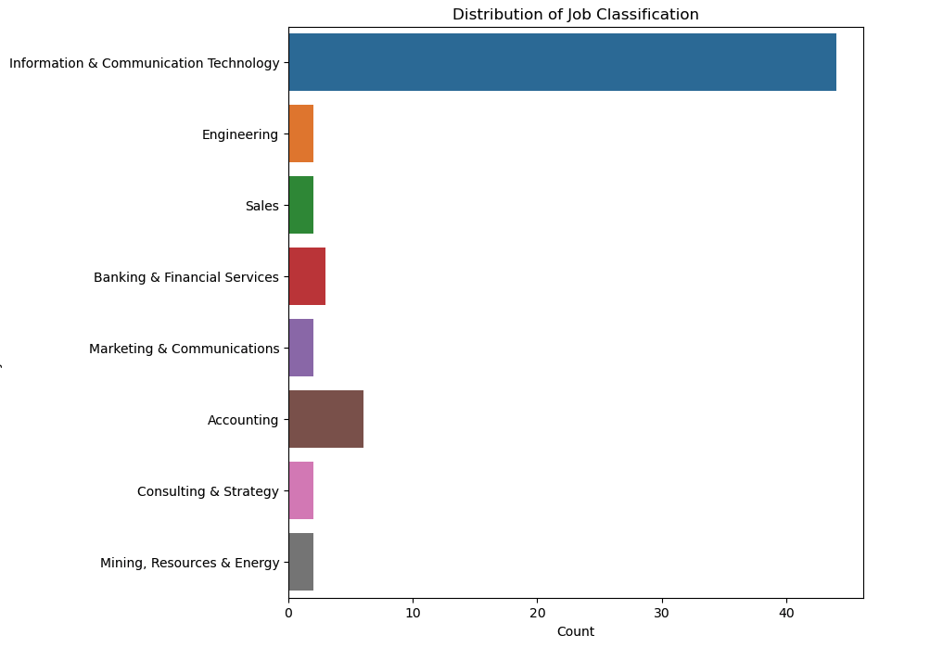

Slide 14
COMPREHENSIVE REVIEW OF THE DATASET
Highest Salaries:
Wellesley Associates and iMiracle HK Limited offer the highest salaries among all companies
Role Comparison:
Product Manager roles are compensated well compared to others
System Analysts are least paid
Regional Insights:
Hung Hom and Kowloon City district have high-paying jobs
Industry Comparison:
Business analyst roles in the IT industry offer more opportunities compared to other industries (e.g., mining, resource energy)

Slide 15

BREAKING THROUGH BARRIERS
The challenges primarily revolved around web scraping from various job portals. Below are the key challenges we faced:
403 Error from Indeed, Monster, and ZipRecruiter:
Our initial attempts to extract data from popular job portals like Indeed, Monster, and ZipRecruiter were met with consistent 403 errors.
Discovery of JobsDB as a Suitable Alternative:
Despite the setbacks encountered with other job portals, our perseverance led us to discover the JobsDB website as a potential solution.

Slide 16

RECAP
&
INSIGHTS
Resilience Redefined : Navigating through Challenges
Data was collected using Web Scraping technique with the help of Beautiful Soup
Cleaned Dataset of many records and attributes was formed after removing nulls, redundancies, outliers etc.
Data was prepared and preprocessed for analysis purpose
To answer the research question, Data Visualization was used, thus the current job trend in Business Analytics in the HongKong Job Market was answered.

Slide 17

Thank you for your time and attention

